Slide 1

Effects of Nested Navigation Patterns on Item-Finding Speed and Error Recovery
Guiller, Gerylyn
Lu, Qinpei
Reyes, Naomi
Weng, Lyrshe
Notes:
Good day. We are Group 6. This presentation covers the data pipeline we propose for our study on nested navigation patterns, and the proposed structure of our Results and Discussion sections, shown with synthetic test data.

Slide 2

What We Will Cover
01
The study in brief
Three navigation patterns, what we measure in every trial, and the test design
02
Data pipeline
How each participant's tap log becomes clean, analysable data, step by step
03
Proposed Results
Every chart in the Results section, what it answers, and why that chart type
04
From results to conclusions
Pre-set decision rules, the Discussion outline, limitations and open decisions
Notes:
We have four parts. First a quick reminder of the study. Then the pipeline that turns the phone's tap log into data we can analyse. Then the proposed Results section, chart by chart, with why each chart is used. Finally the rules we fixed in advance for turning results into conclusions, and the Discussion outline.

Slide 3
The Study in Brief
‹ Back Social Services
Services
Forms
News
About
Services ▾
Senior citizen benefits ›
Social
Health
Permits
Social ▾
Link 1.1
Link 2.1
Link 3.1
Senior benefits
Disability assistance ›
Link 1.2
Link 2.2
Link 3.2
Disability aid
Solo parent support ›
Link 1.3
Link 2.3
Link 3.3
Health ▸
Burial assistance ›
Forms ▸
DH
Deep hierarchical
MM
Mega-menu
ND
Nested dropdown
Tapping an item replaces the list with its children; Back goes up one level.
Tapping a category opens one panel with all subgroups and their links at once.
Lists open beneath their parent, indented, one level at a time.
Selections to reach a page: 3
Selections to reach a page: 2
Selections to reach a page: 3
15
participants, 5 per order sequence
6
timed tasks each, 2 per pattern
3×3
Latin square balances the order
180 s
limit per task, in person, one phone
Notes:
Every participant uses all three menu styles of the same simplified government site: deep hierarchical, mega-menu and nested dropdown. Content, labels and targets are identical; only the presentation differs. The mega-menu needs two taps instead of three because it shows two levels at once; that is part of the pattern. Fifteen participants, six tasks each, with a Latin square to balance order.

Slide 4
What We Measure in Every Trial
Error episode
Start
C4
C4.1
Back
C4.3
C4.3.2
tap Start
correct
WRONG
to C4
correct
target
0.0 s
2.6 s
4.5 s
7.0 s
9.9 s
11.2 s
T_find = 11.2 s (Start → target)
T_clean
R = 2.5 s
T_clean (8.6 s in total = T_find − R)
Real trace from the dummy data: participant P03, task T4, deep hierarchical menu. One wrong tap (E = 1); Back returns to the correct path.
T_find
H1
E
H2
R
H3
T_clean
RQ3
+
Item-finding time
Errors
Recovery time
Clean navigation
Secondary
Start tap to target selected.
Taps on items that are not on the correct path.
Sum of error episodes: wrong tap until back on the correct path.
T_find − R: scanning and correct taps only.
Task success, difficulty rating (SEQ 1–7), preference rank.
Notes:
This is one real trial from our test data. The participant tapped C4, then the wrong subcategory C4.1 at 4.5 seconds. That opens an error episode, which ends when they are back on the correct path, here by tapping Back at 7.0 seconds. Recovery time R is the length of the episodes, 2.5 seconds. Item-finding time is the whole trial, 11.2 seconds, and clean navigation time is what is left, 8.6 seconds. This split is what lets us answer RQ3.

Slide 5
01
Data Pipeline
From the phone's tap log to tables, figures and decisions, in seven checked steps.
Notes:
Part one: the data pipeline.

Slide 6
Pipeline Overview
1 COLLECT
2 VALIDATE
3 CLEAN
4 DERIVE
5 DESCRIBE
6 INFER
7 CONCLUDE
Prototype logs every tap; questionnaires add ratings and demographics
17 checks on structure, timing, menu tree, design and completeness
Remove duplicates, practice trials and logged app faults; nothing else
Event log becomes one row per trial: E, R, T_find, T_clean, success
Per-pattern summary tables and 10 figures for the paper
Mixed models and GEE, Holm-corrected pairs, fallback and sensitivity
Pre-set rules give H1–H3 decisions, limitations and draft text
events.csv
ratings.csv
participants.csv
validation_report.csv
cleaning_log.csv
trials.csv
episodes.csv
desc_*.csv
F1–F10
model_*.csv
F11–F12
hypothesis_
decisions.csv
results_draft.md
Output files
One command runs all seven steps: python scripts/run_pipeline.py --data-dir <export folder>
Same code for the dummy data and the real exports · stops if the data fails a hard check · 43 automated tests · Python (pandas, statsmodels) with Jupyter notebooks for each step
Notes:
The whole pipeline is seven steps, each producing a file we can inspect. Collect, validate, clean, derive the trial metrics, describe and plot, run the models, and conclude. One command runs everything, on the dummy data now and on the real exports later, and five notebooks narrate each step for the group.

Slide 7
Inputs: What We Collect
E
events.csv
R
ratings.csv
P
participants.csv
One row per tap or menu action
One row per task
One row per participant
Source: Prototype logger (primary data)
Source: On-device question after each task
Source: Demographic and final questionnaires
Holds: time since Start, item tapped, item now shown, pattern, task, target
Holds: difficulty rating, 1 = very difficult to 7 = very easy (SEQ)
Holds: age, gender, familiarity with gov. sites, prior use, preference rank
X
exclusions.csv
T
tree.csv + tasks.csv
–
Not analysed
One row per excluded trial
The menu and the targets
Screen recordings
Source: Researcher, from screen recordings
Source: Phase 2 prototype build
Source: Backup only
Holds: trial ID and reason; device or app faults only
Holds: every menu item and its parent; each task's target page
Holds: used to spot-check the log and to justify exclusions
Notes:
Everything the analysis needs is in five small files per dataset. The tap log is the primary data; the ratings and questionnaires add the secondary outcomes and covariates; exclusions lists only trials with a confirmed device or app fault; and the tree file lets the pipeline recompute which taps were on the correct path instead of trusting the app.

Slide 8
Dummy Dataset
Why: build and test the whole pipeline before any participant is recruited.
15
816
A simulator walks virtual participants through the menu tree, tap by tap, and writes exactly the files the prototype will export.
Effects are planted on purpose (mega-menu fastest, nested dropdown most errors) so we can check that the analysis finds them.
A “dirty” copy has 8 injected faults, such as duplicated rows, timestamps going backwards and unknown menu items, that the validator must catch.
The simulator records the true E, R and T_find of every trial; the pipeline must reproduce them exactly.
simulated participants, 5 per sequence
logged taps and actions in 105 trials
8 / 8
89 / 89
injected faults caught by the validator
analysed trials match the true E, R and T_find
Every number in the Results part of this deck comes from this synthetic data. It shows the structure of the section, not findings.
Notes:
Because we have no participants yet, we built a simulator. It produces data in exactly the format the prototype will export, with effects we planted on purpose. That lets us check two things: that the cleaning catches broken data, and that the derived numbers match the truth exactly. Everything in the results part of this deck is from this synthetic data, so it illustrates the structure, not findings.

Slide 9
Validate & Clean
Any hard
failure?
Raw export
5 CSV files
17 checks
listed below
no
Clean
remove only 3 things
Clean data
+ cleaning log
yes
exact duplicate rows
practice trials
trials in exclusions.csv (app faults)
No outlier removal: slow trials are real data.
STOP: fix the raw export
and note the fix in the log
Hard checks: the run stops
Soft checks: reported, then handled
exactly one Start and one end event per trial
timestamps never go backwards; nothing after 180 s
every tapped item exists in the menu tree
each trial's target matches the task list
minimum selections match the pattern (2 for MM, 3 otherwise)
6 trials per participant, 5 participants per sequence
pattern and task order match the Latin square
app's on-path flag agrees with the menu tree
no duplicate rows; ratings and rankings complete
every exclusion names a known trial and a reason
Notes:
Every export goes through 17 checks. Hard failures, such as timestamps going backwards or a tapped item that is not in the menu, would make the derived numbers wrong, so the run stops and lists the problem. Soft problems are reported and handled explicitly. Cleaning removes only three things and logs each one. We never remove slow trials as outliers.

Slide 10
Preprocessing: Log → One Row per Trial
Event log for one trial (P03, T4, deep hierarchical)
Trial row in trials.csv
Time (s) | Action | Item | Correct path?
0.0 | Start |  | yes
0.9 | open menu |  | yes
2.6 | tap | C4 | yes
4.5 | tap | C4.1 | NO (error)
7.0 | Back | → C4 | yes (episode ends)
9.9 | tap | C4.3 | yes
11.2 | tap | C4.3.2 | target reached
E
1
one tap off the correct path (C4.1)
R
2.5 s
wrong tap at 4.5 s until Back at 7.0 s
T_find
11.2 s
Start until the target is selected
T_clean
8.6 s
T_find − R
success
yes
target reached before 180 s
Error: a tap on any item that is not on the root-to-target path P*. Menu open/close and Back are actions, not selections.
Episode: starts at an error, ends when the shown item is back on P* (a correct tap, or Back/collapse landing on it). If the trial ends first, it ends at the trial end.
Failed trials: give-up or 180 s time-out keep T_find = trial end with success = 0, and are left out of the time and error models.
Notes:
Pre-processing turns the tap log into one row per trial. The pipeline recomputes which taps were on the correct path from the menu tree, finds the error episodes and computes E, R, T_find and T_clean. On the dummy data these match the simulator's true values for all 89 analysed trials. Failed trials keep their time but are flagged as unsuccessful.

Slide 11
Analysis Plan: One Model per Outcome
Outcome | Tests | Trials used | Model | Effect size reported
Item-finding time, T_find | H1 | successful | Linear mixed model on log time, random intercept per participant | ratio of geometric means
Error count, E | H2 | successful | Poisson GEE clustered by participant (negative binomial if over-dispersed) | rate ratio
Recovery time, R | H3 | successful, E ≥ 1 | Linear mixed model on log time | ratio of geometric means
Task success | – | all | Logistic GEE clustered by participant | odds ratio
Clean time, difficulty (SEQ) | secondary | as above | Linear mixed model | ratio / difference
Every model
Then
Why these models
pattern + block position as fixed effects; α = .05, two-sided
omnibus Wald test; if significant, 3 pairwise contrasts with Holm correction
each participant does 6 trials, so trials are not independent; times are right-skewed
Notes:
Each outcome gets the model that fits its type, as in Table 4 of the proposal. Times are skewed, so we model log time and report ratios. Errors are counts. Success is yes or no. Every model accounts for each participant contributing several trials. One change from the proposal: Python has no negative-binomial or logistic mixed model, so errors and success use GEE, which gives population-averaged effects. We will state that in the paper.

Slide 12
Safety Nets: Fallback & Sensitivity
Fit the primary model
Rule fixed in advance. Both tests are always computed and reported; the rule only decides which one the decision uses.
Sensitivity analyses
Re-run H1–H3 three other ways. If the answer changes, it becomes a limitation.
Converged and
estimable?
no
1
Drop block 1
Removes warm-up effects from the first pattern used.
yes
Friedman test
+ Wilcoxon pairs (Holm)
on participant averages
Residuals OK?
Shapiro & Levene
p ≥ .01
2
Add covariates
no
Familiarity with government sites and prior use of the reference site.
Too few participants for Friedman? Keep the primary model and report the flag.
yes
3
Keep failed trials
Decide with the primary model
Cox model treats give-ups and time-outs as unfinished (censored at 180 s).
Dummy data: success (100% in ND, not estimable) and SEQ (non-normal ratings) switched to Friedman; 8 of 10 sensitivity runs agreed.
Notes:
Two safety nets. First, a fallback rule written before seeing data: if the main model cannot be estimated or its assumptions clearly fail, the decision uses a Friedman test instead. Both are always reported. Second, three sensitivity analyses check whether the answer survives dropping the first block, adding covariates, and keeping failed trials as censored. Disagreements are reported as limitations, not hidden.

Slide 13

02
Proposed Results
Every chart that follows uses synthetic data. It shows the structure of the Results section, not findings.
Notes:
Part two: the proposed Results section. Remember that all numbers here are from the dummy data.

Slide 14
Results Section at a Glance
1
2
3
4
Participants & trials
Task success
H1 · Item-finding time
H2 · Errors
Who took part and how much data each test uses
How many trials reached the target, and what is excluded
Does the pattern change how fast users find the item?
Does the pattern change how often users go the wrong way?
Table
F5
F1
F2
5
6
7
8
H3 · Recovery time
Why time differs (RQ3)
Secondary & paths
Checks & decisions
Does it change how long getting back on track takes?
Recovery or slower correct navigation? How big are the gaps?
Difficulty, preference, and where users go wrong
Order effects, model checks, and the H1–H3 decisions
F3
F4 · F12
F6 F7 F9 F10
F8 F11 · table
Notes:
This is the order of the Results section. We start with who took part and which trials count, then answer H1, H2 and H3 in turn, then explain why times differ, then the secondary outcomes and path analysis, and finish with the checks and the formal decisions. The highlighted cards are the three hypotheses.

Slide 15



Participants and Trials
  15 participants, 5 per sequence
  Age 31.1 ± 6.9 years (20–40)
  7 had used the reference site
  Familiarity with gov. sites: 2.8 / 5
  89 trials analysed, 85 successful
  Practice + 1 app-fault trial removed
Why first: tells readers who the results apply to and how much data each test rests on.
ILLUSTRATIVE · SYNTHETIC DATA
Notes:
The Results open with the sample: who took part, and how many trials each analysis rests on. Practice trials and trials with a confirmed app fault are removed before anything else, and both are logged.

Slide 16
Per-Pattern Summary
ILLUSTRATIVE · SYNTHETIC DATA
  Why a table: exact values for the text; the charts that follow show the same numbers visually.
  Illustrative pattern: mega-menu fastest; nested dropdown slowest and most error-prone.
Pattern | Trials | Success | Median T_find | Mean errors | Trials with ≥ 1 error | Median R | Mean SEQ (1–7)
Deep hierarchical (DH) | 30 | 93% | 9.5 s | 0.50 | 29% | 4.8 s (n = 8) | 5.07
Mega-menu (MM) | 29 | 93% | 7.4 s | 0.33 | 33% | 2.6 s (n = 9) | 5.69
Nested dropdown (ND) | 30 | 100% | 13.1 s | 0.90 | 47% | 4.8 s (n = 14) | 5.53
T_find, errors and R use successful trials; R only trials with at least one error; SEQ all trials.
Notes:
One table carries the exact numbers that the text cites: success, median item-finding time, mean errors, recovery time and the difficulty rating for each pattern. The charts that follow show the same numbers visually.

Slide 17
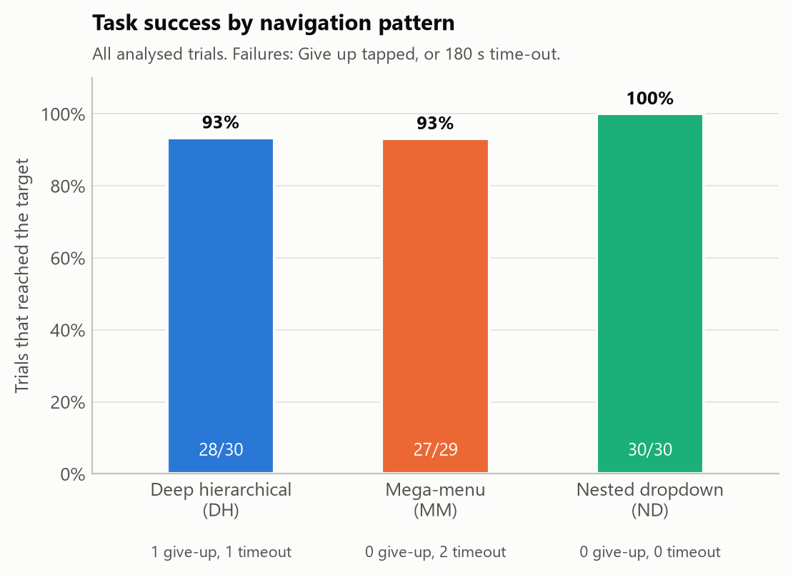
Task Success
ANSWERS
Did participants reach the target? This decides which trials enter the time and error models.
WHY THIS CHART
Success is one proportion per pattern, so a plain 0–100% bar compares three values at a glance. Counts and failure types under each bar show exactly what is excluded.
IN THE DUMMY DATA
93–100% success. 4 failures (1 give-up, 3 time-outs) are left out of H1–H3 and covered by the censored sensitivity model.
ILLUSTRATIVE · SYNTHETIC DATA
Notes:
We show success first because only successful trials enter the time and error models. A plain bar per pattern is enough for three proportions; the counts and failure types underneath show what is excluded.

Slide 18
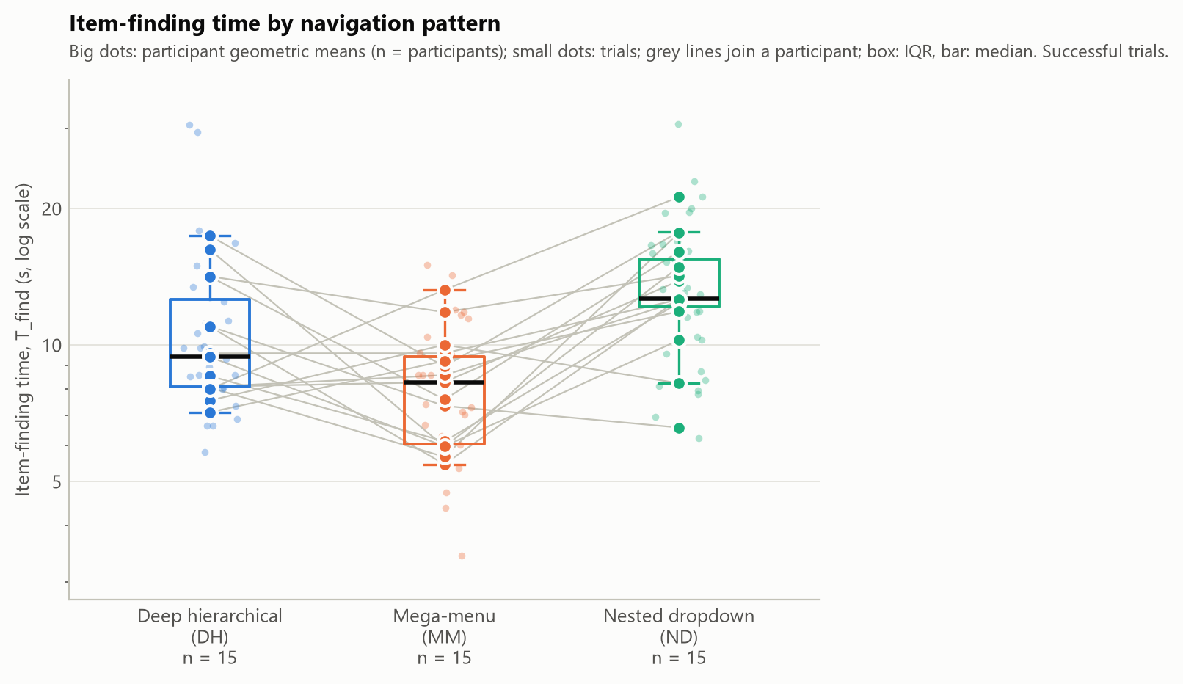
H1 · Item-Finding Time
ANSWERS
H1 and RQ4: does the navigation pattern change how fast users find the item?
WHY THIS CHART
Times are skewed and every participant uses all three patterns. Boxes show median and spread, grey lines join each participant's own results, and the log axis matches the log-time model.
IN THE DUMMY DATA
Mega-menu 23% faster than deep hierarchical; nested dropdown 27% slower (mixed model, p < .001).
ILLUSTRATIVE · SYNTHETIC DATA
Notes:
Item-finding time is skewed, so we use a log axis, the same scale the model uses. Each grey line is one participant, which shows the within-subject comparison directly. In the dummy data mega-menu is fastest and nested dropdown slowest.

Slide 19
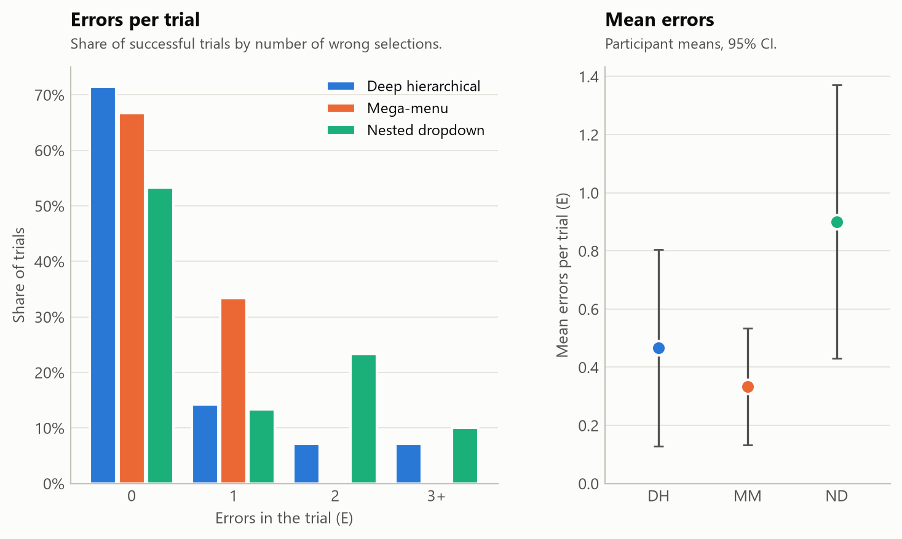
H2 · Errors
ANSWERS
H2: do the patterns differ in how often users tap a wrong item?
WHY THIS CHART
Errors are small counts, mostly 0, 1 or 2. The left panel shows that shape, which a mean hides; the right panel shows the mean with the 95% interval the test is based on.
IN THE DUMMY DATA
Nested dropdown 0.90 errors per trial vs mega-menu 0.33: 2.6 times as many (p = .008 after Holm).
ILLUSTRATIVE · SYNTHETIC DATA
Notes:
Errors are counts with many zeros, so we show the full distribution as well as the mean with its confidence interval. In the dummy data the nested dropdown has the most errors.

Slide 20
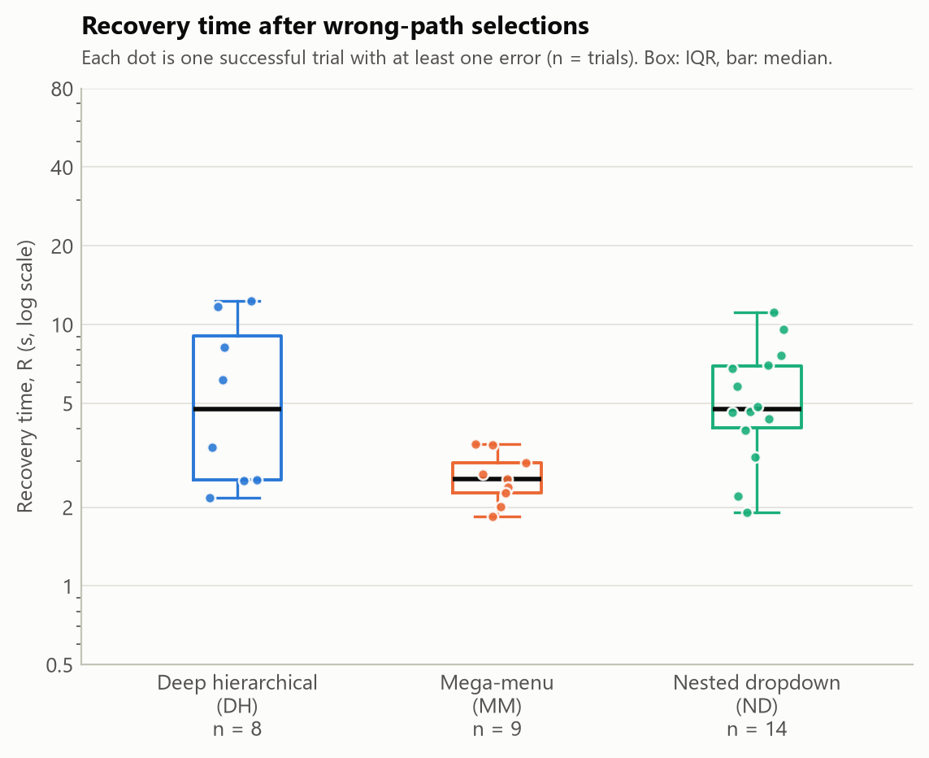
H3 · Recovery Time
ANSWERS
H3 and RQ3: once users go the wrong way, how long until they are back on the correct path?
WHY THIS CHART
Only trials with at least one error have a recovery time, so every trial is a dot and n is printed under each box: readers see how little data sits behind each pattern.
IN THE DUMMY DATA
Nested dropdown recoveries 91% longer than mega-menu. Only 8–14 trials per pattern, so read with care.
ILLUSTRATIVE · SYNTHETIC DATA
Notes:
Recovery time exists only for trials with errors, so we show every trial and print n. In the dummy data that is 8 to 14 trials per pattern, which is why the H3 result carries a caution.

Slide 21
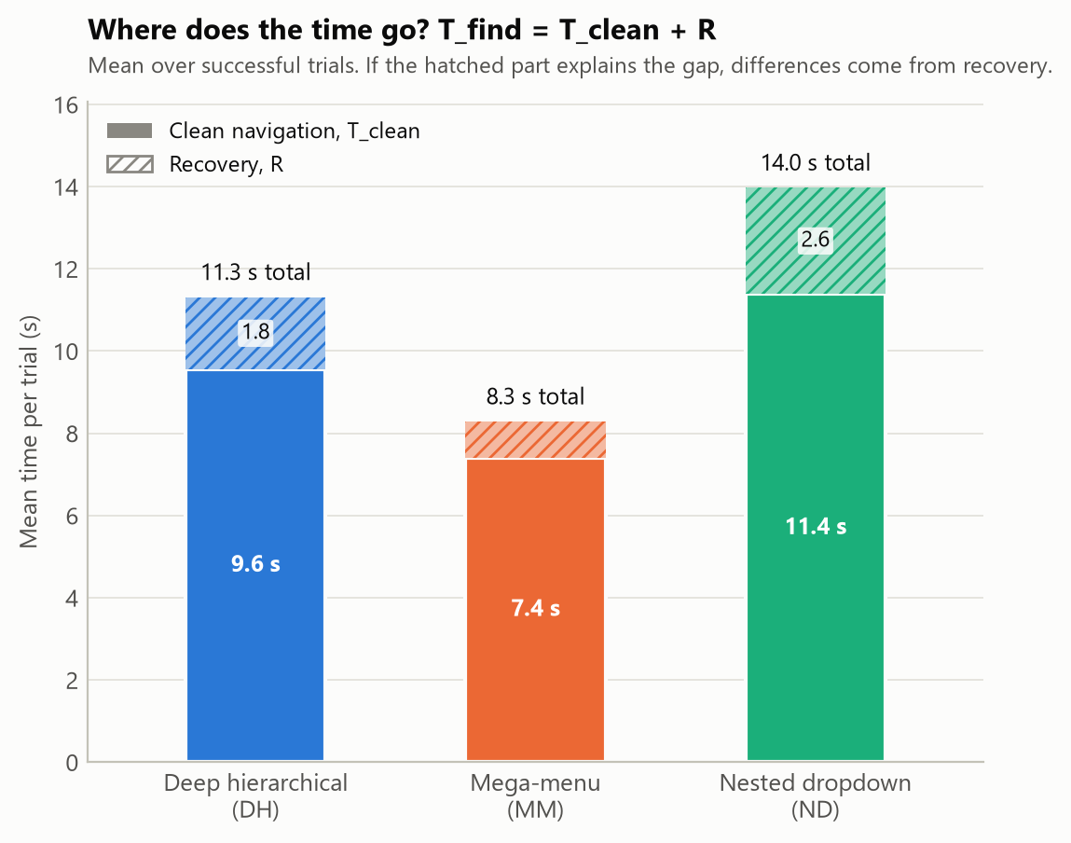
Why Does Time Differ?
ANSWERS
RQ3 and Eq. 2: is a pattern slow because of errors, or because correct navigation is slower?
WHY THIS CHART
T_find = T_clean + R adds up exactly, so a stacked bar splits each pattern's mean time into its two parts. A hatched top that changes a lot points to recovery.
IN THE DUMMY DATA
Recovery explains only about 30% of the gaps; most of the difference is in clean navigation.
ILLUSTRATIVE · SYNTHETIC DATA
Notes:
Because item-finding time is exactly clean time plus recovery time, a stacked bar is the natural chart. In the dummy data the solid parts differ more than the hatched parts, so the differences come mainly from clean navigation.

Slide 22
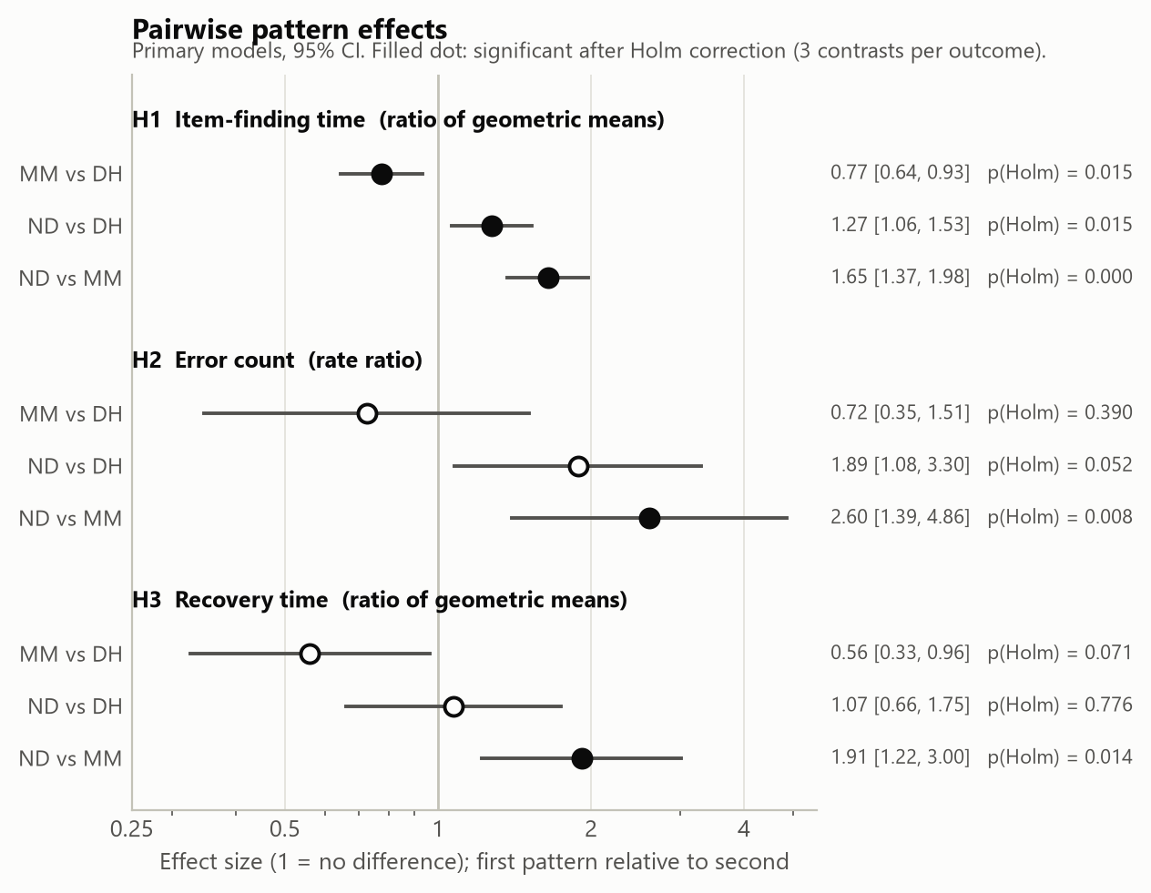
How Big Are the Differences?
ANSWERS
Which pairs of patterns differ, and by how much?
WHY THIS CHART
p-values hide size. A forest plot puts every pairwise ratio and its 95% interval on one scale; an interval crossing 1 means no detectable difference. Filled dots survive Holm correction.
IN THE DUMMY DATA
All three H1 pairs differ. For errors and recovery only nested dropdown vs mega-menu survives correction.
ILLUSTRATIVE · SYNTHETIC DATA
Notes:
This chart gives the size of each difference with its uncertainty, which p-values alone do not. Any interval that crosses one means we cannot tell those two patterns apart.

Slide 23
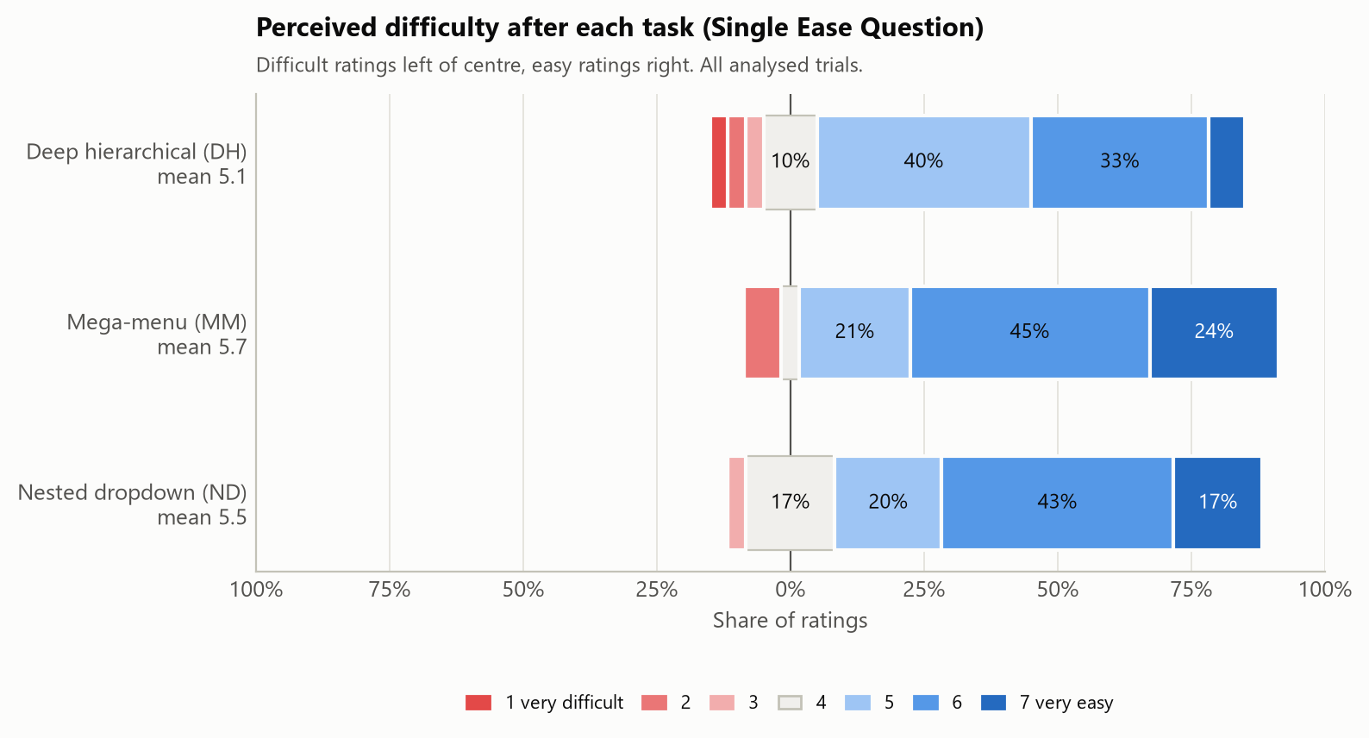
Secondary · Difficulty
ANSWERS
How hard did each pattern feel? This supports, rather than tests, H1–H3.
WHY THIS CHART
The Single Ease Question is a 1–7 ordinal rating. Diverging stacked bars keep every category visible and centre on the neutral 4, instead of averaging an ordinal scale into one number.
IN THE DUMMY DATA
Mega-menu rated easiest (mean 5.7); the differences are not significant (Friedman p = .205).
ILLUSTRATIVE · SYNTHETIC DATA
Notes:
Perceived difficulty is a secondary outcome. Because the rating is ordinal, we show the whole distribution around the neutral point rather than only a mean. Difficult ratings sit left of centre, easy ratings right.

Slide 24
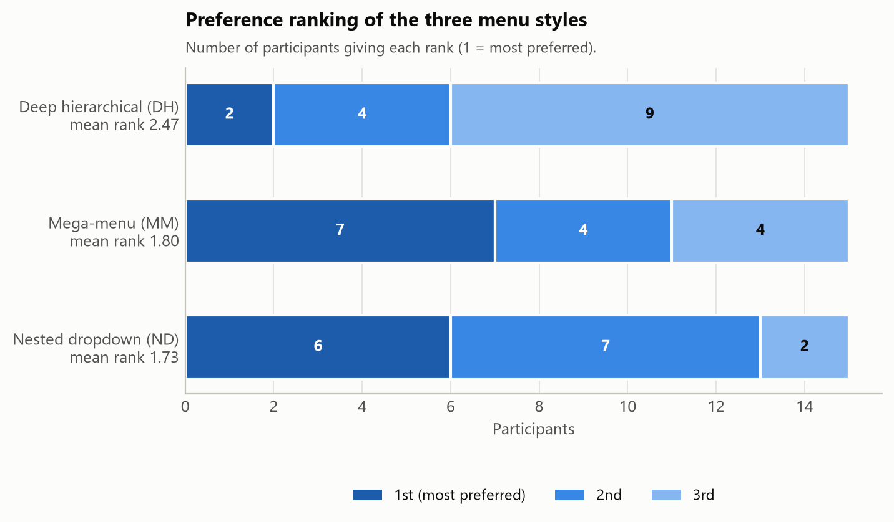
Secondary · Preference
ANSWERS
After using all three, which menu style did participants prefer?
WHY THIS CHART
Each participant ranks the three styles, so the data are counts of 1st, 2nd and 3rd places per pattern. Stacked bars show the whole split; the mean rank on each label sums it up.
IN THE DUMMY DATA
Mega-menu and nested dropdown preferred over deep hierarchical (mean ranks 1.80 and 1.73 vs 2.47; p = .085).
ILLUSTRATIVE · SYNTHETIC DATA
Notes:
Preference is a ranking, so we count how many people put each style first, second and third. It complements the performance results: a style can be preferred even when it is not the fastest.

Slide 25
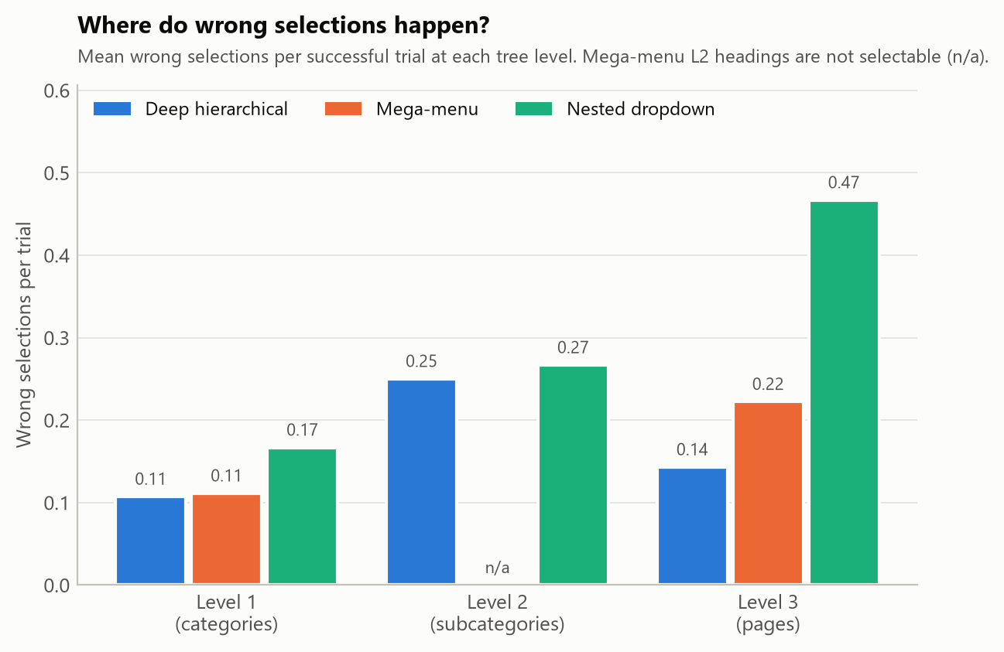
Paths · Where Errors Happen
ANSWERS
At which menu level do users take a wrong turn, for each pattern?
WHY THIS CHART
Grouped bars put the three patterns side by side within each menu level, so the level that causes trouble stands out. The mega-menu has no tappable level 2, shown as n/a.
IN THE DUMMY DATA
Nested dropdown errors concentrate at level 3, with 0.47 wrong taps per trial.
ILLUSTRATIVE · SYNTHETIC DATA
Notes:
Because we log every tap, we can see where users go wrong, not just how often. This chart shows which level of the menu tree produces the wrong taps for each pattern.

Slide 26
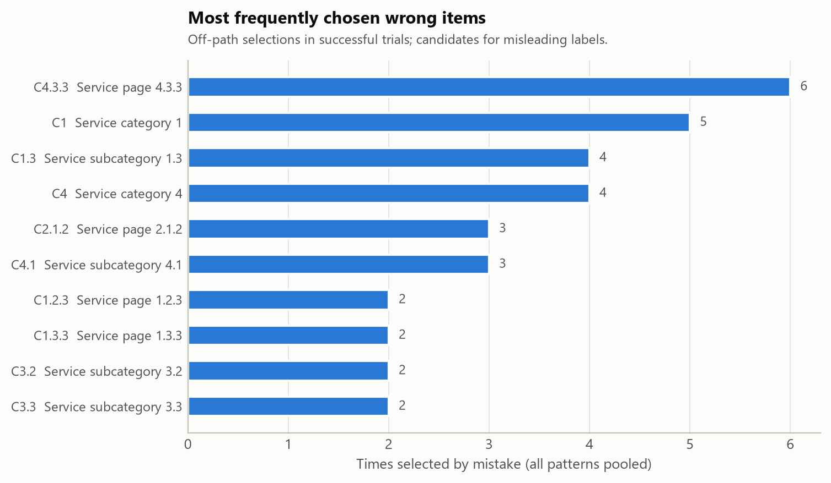
Paths · Misleading Items
ANSWERS
Which menu items are tapped by mistake most often? These feed the design advice.
WHY THIS CHART
A sorted horizontal bar chart ranks items from most to least often chosen by mistake, and the horizontal layout leaves room for long menu labels.
IN THE DUMMY DATA
The dummy tree has placeholder labels, so this means nothing yet. With real labels, the top items are candidates for rewording.
ILLUSTRATIVE · SYNTHETIC DATA
Notes:
This ranks the menu items most often tapped by mistake. With the real government-site labels, these are the candidates for clearer wording, which is one of the concrete design implications we expect to discuss.

Slide 27
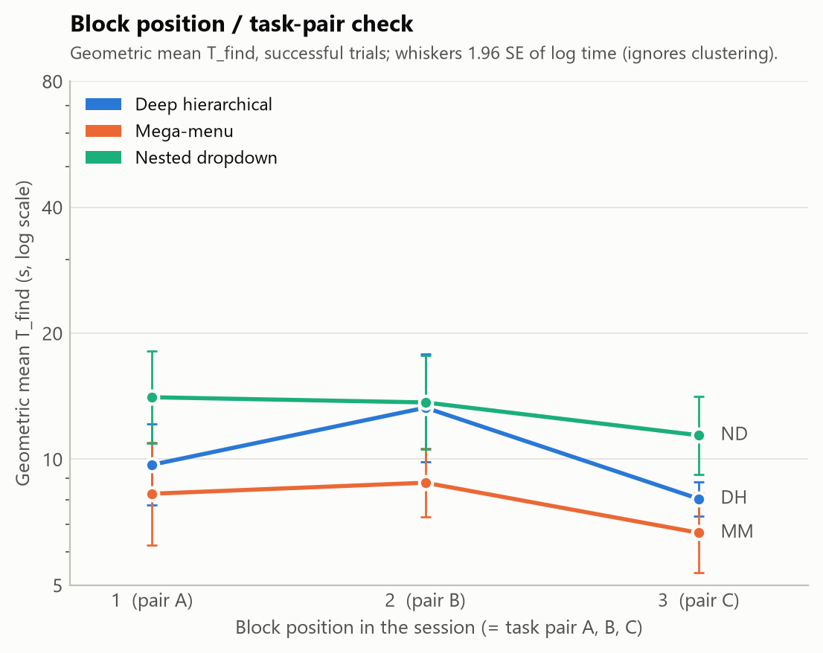
Check · Order Effects
ANSWERS
Did participants get faster over the session, whatever the pattern?
WHY THIS CHART
One line per pattern across the three blocks shows learning or fatigue at a glance. In our Latin square, block and task pair are the same factor, so the axis names both.
IN THE DUMMY DATA
Times drop in block 3 for every pattern, so we cannot tell learning apart from an easier task pair C.
ILLUSTRATIVE · SYNTHETIC DATA
Notes:
This is a check, not a result. Lines that fall from block to block mean people got faster. Because block 1 is always task pair A in our design, a fall could also mean pair C is easier, which is why we list it as an open decision.

Slide 28
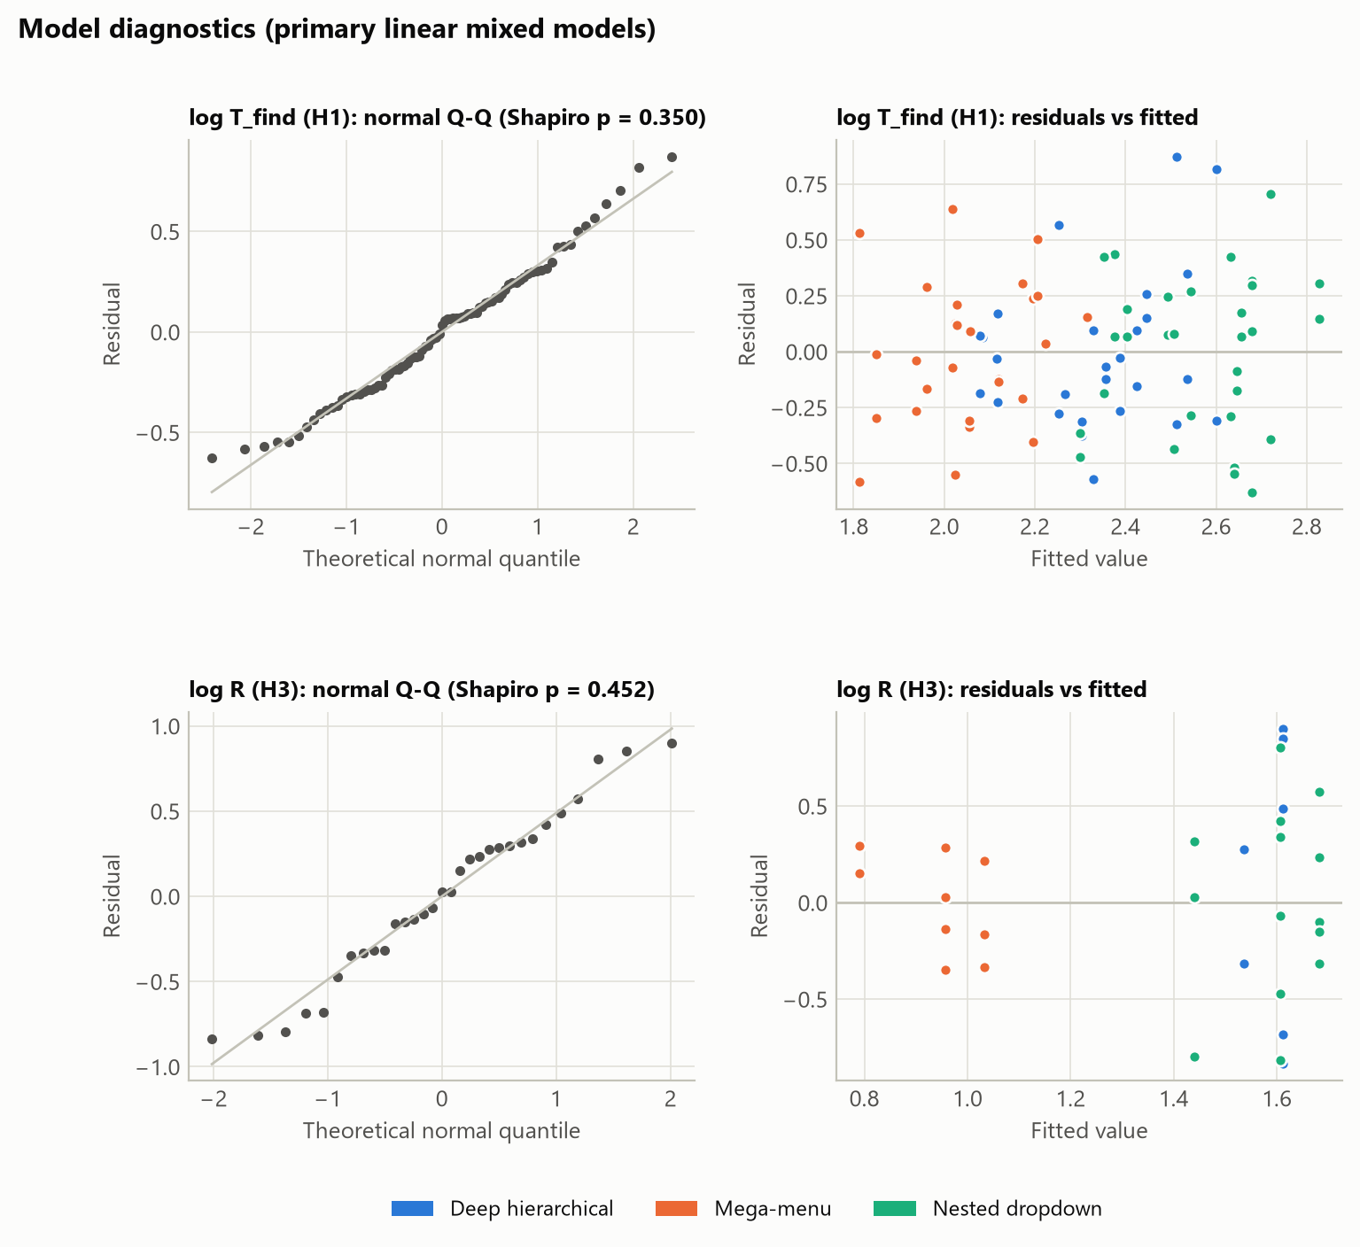
Check · Model Assumptions
ANSWERS
Can we trust the mixed models for H1 and H3, or should the decision use the fallback test?
WHY THIS CHART
A Q-Q plot shows whether residuals are normal (points on the line); residuals against fitted values show unequal spread (a funnel). These are the two conditions in the fallback rule.
IN THE DUMMY DATA
Log T_find residuals look normal. R shows unequal spread across patterns, so H3 carries a caution.
ILLUSTRATIVE · SYNTHETIC DATA
Notes:
These diagnostics decide whether the main model can be used. Points on the line and no funnel shape mean the assumptions hold. For recovery time the spread differs between patterns, so H3 is reported with a caution.

Slide 29

03
From Results to Conclusions
Decision rules fixed in advance, the decisions they give, and the Discussion outline.
Notes:
Part three: how we turn results into conclusions.

Slide 30
How We Draw Conclusions
1
Reject or not
2
Which patterns differ
H1–H3 are null hypotheses. Reject one only if its omnibus test (primary model, or Friedman when flagged) gives p < .05. Otherwise we “fail to reject”: never “no difference”, since 15 participants may miss small effects.
Pairwise contrasts only after a significant omnibus test, and only those that survive Holm correction, each with its effect size and 95% confidence interval.
3
Why it differs (RQ3)
4
How sure we are
T_find = T_clean + R splits every gap exactly. Recovery ≥ half the gap and no T_clean effect: “mainly recovery”. The reverse: “mainly clean navigation”. Otherwise: “both”.
Report how many sensitivity analyses agree, and every flag, in a limitations checklist that the pipeline generates from the data.
These rules are written into the code before data collection, so the conclusions cannot be tuned to the results.
Notes:
Four rules, fixed in advance and written into the code. When to reject a null hypothesis. Which pairwise differences we report. How we decide whether a time difference comes from recovery or from slower correct navigation. And how we report uncertainty. Because the rules are fixed, the conclusions cannot be tuned after we see the data.

Slide 31
Hypothesis Decisions
ILLUSTRATIVE · SYNTHETIC DATA
 | Null hypothesis: no difference across patterns in… | Test | Result | Decision | Pairs that differ (Holm)
H1 | item-finding time | Linear mixed model, log T_find | χ²(2) = 28.35, p < .001 | Reject H1 | all three pairs
H2 | error count | Poisson GEE | χ²(2) = 11.51, p = .003 | Reject H2 | ND vs MM
H3 | recovery time | Linear mixed model, log R | χ²(2) = 8.50, p = .014 | Reject H3 | ND vs MM
Why time differs (RQ3)
Robustness
Caution
Recovery explains about 30% of the gaps, and clean navigation time also differs, so the differences are mainly in clean navigation, not recovery.
8 of 10 analyses agree. Dropping block 1 removes the H2 and H3 effects, so this is reported as a limitation.
H3 rests on only 8–14 trials with errors per pattern, and its residual spread was flagged.
Notes:
Applying the rules to the dummy data gives this table: all three null hypotheses are rejected, but only the nested dropdown versus mega-menu pair survives correction for errors and recovery. The decomposition says the differences come mostly from clean navigation. The checks show H2 and H3 are fragile, which is exactly what the limitations section would report. With real data this table is regenerated automatically.

Slide 32
Proposed Discussion Structure
1
Answer the research questions
Restate the H1–H3 decisions in plain words, with effect sizes rather than p-values alone.
Decision table · F12
2
Explain the mechanism
Is a pattern slow because users go the wrong way, or because correct navigation itself is slower?
F4 · decomposition table
3
Locate the problems
Which tree levels and which labels send users down the wrong path, for each pattern.
F9 · F10 · confusion table
4
Design implications
What designers of Philippine government sites should do with nested menus, and for which goals.
All of the above
5
Limitations & future work
From the generated checklist: sample size, failed trials, aliasing, one site and one phone.
Limitations checklist
Notes:
The Discussion follows five steps. Answer the research questions with effect sizes. Explain why times differ. Locate where users go wrong using the path analysis. Turn that into concrete design advice for government sites, which is the contribution of the paper. And close with limitations and future work, taken from the generated checklist.

Slide 33
Limitations & Open Decisions
Limitations we will report
Decide before data collection
15 participants: a non-significant result means “not detected”, not “no difference”.
Failed trials are left out of the time and error models; the censored Cox model checks the effect of that.
One reference site, one phone model, and a convenience sample of friends and family.
The mega-menu needs 2 taps instead of 3; that is part of the pattern, so it is reported, not removed.
No correction across H1–H3 (Holm is applied within each hypothesis).
Sample per sequence. The proposal says “ten per sequence”; with N = 15 it is five.
Block vs task pair. In Table 3, block 1 is always pair A, so learning and task difficulty cannot be separated. Varying the pair order fixes this.
GEE for errors and success. A change from the mixed models in Table 4; to be stated in the paper.
Final N. Confirm after the pilot power analysis, as a multiple of 3.
Notes:
On the left, the limitations the paper will state. On the right, four points the group should settle before data collection. The most important one is that, in our Latin square, block position and task pair are the same factor, so a learning effect cannot be separated from task difficulty. Varying the pair order across sequences would fix it.

Slide 34



[HCI2000] Group 6
THANK YOU
Notes:
Thank you. We welcome questions, especially on the open decisions about the design.

